Slide 1
Investigating The Factors Influencing The Salaries of Data Scientists.
Salako Olalekan

Slide 2
Agenda
Introduction
Methods/Approaches
Results
Discussion
Conclusion

Slide 3
Introduction
- The aim of this study is to investigate the factors influencing the salaries of Data Scientists. - To achieve this, a dataset containing various relevant variables was utilized. This report describes the exploratory analysis conducted to understand the relationship between these factors and Data Scientists' salaries.

Slide 4
Methods/Approaches
Data Collection
Reading The Datasets
Viewing The Datasets
Data Cleaning and Preparation

Slide 5
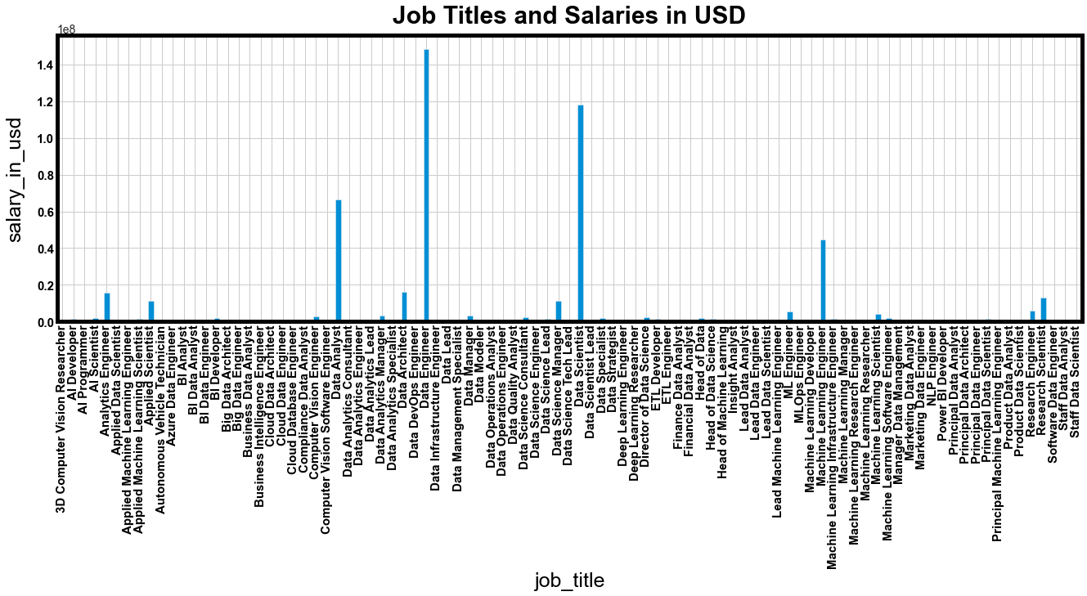
Results: Data Engineer is the highest paid based on Salaries in USD.
While Data Scientist and Data Analyst follow respectively

Slide 6
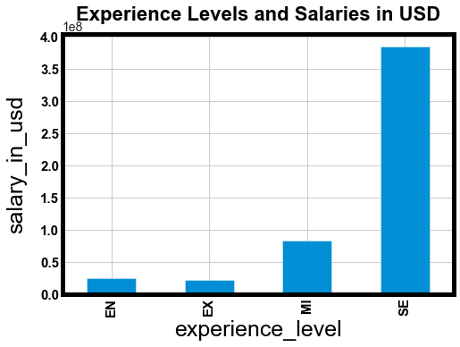
Senior level or Expert in Data Science earns more money than other experience levels.

Slide 7
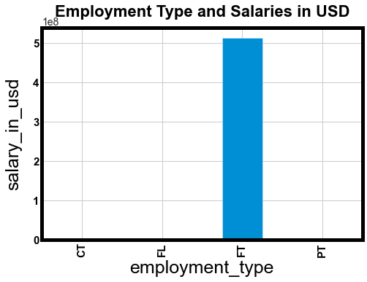
Full-Time(FT) Data Scientist earns more money than other Employment Type.

Slide 8
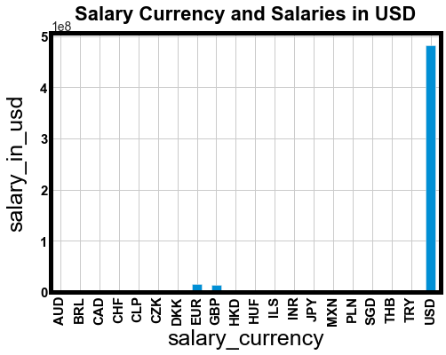
Data Scientists that get paid in USD earn more money than those that earn in other currencies.

Slide 9
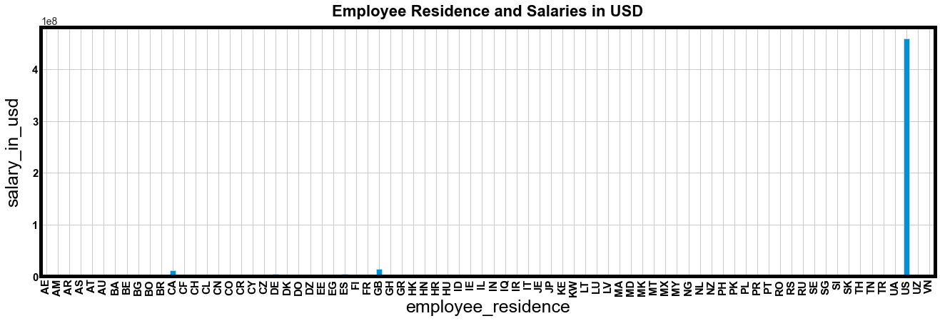
Data Scientists that live in the US earn more money than others that live in other countries.

Slide 10
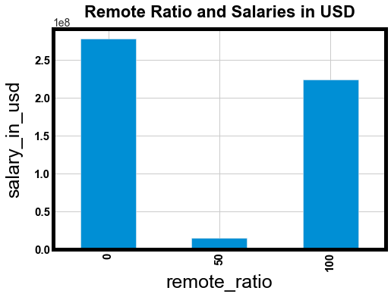
Data Scientists that work On-Site get paid more than those that work remotely.

Slide 11
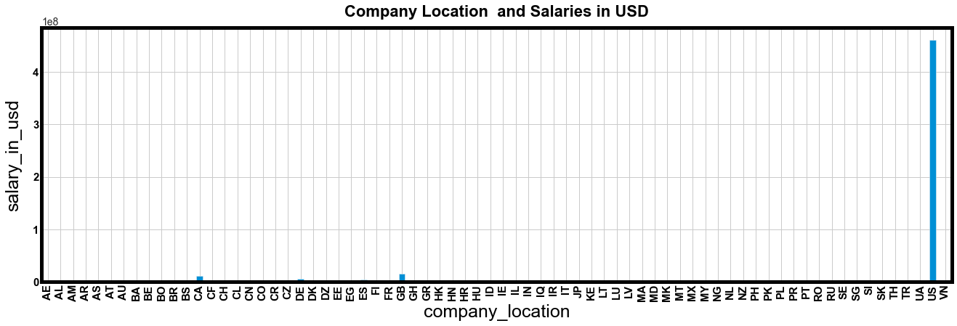
Companies located in the US pay more salaries to Data Scientists than other companies located elsewhere.

Slide 12
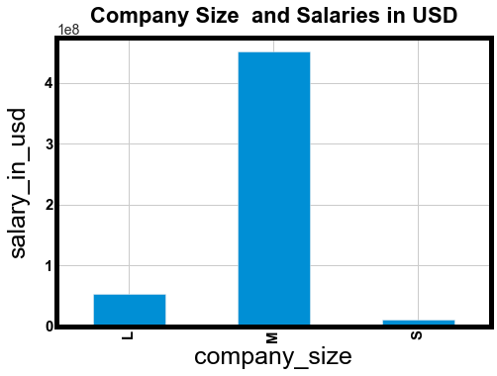
Medium-sized companies pay more salaries to Data Scientists than both Large and Small-sized companies.

Slide 13
Conclusion
According to this analysis, Senior-Level/expert, Full-Time, Data Scientists that earn salary in USD, live and work in the United State of America get paid more than others.

